Slide 1

Business Statistics Introduction to Statistics
Module - 3
Presentation By
Mohammed Tahir Mirji
MTech CS

Slide 2
CONTENTS
What is Statistical Learning?
Introduction to Data
Data Presentation Using Charts and Diagrams
Measuring of Central Tendency, Variance
Understanding of Normal Distribution
Data Pre-processing
Feature Engineering ( Feature Extraction and Normalization)
Assignments
Code Examples Github Link

Slide 3
What is Statistical Learning?
Statistics
Statistics simply means numerical data, and is field of math that generally deals with collection of data, tabulation, and interpretation of numerical data.
It is actually a form of mathematical analysis that uses different quantitative models to produce a set of experimental data or studies of real life.
It is an area of applied mathematics concern with data collection analysis, interpretation, and presentation. Statistics deals with how data can be used to solve complex problems.
Basic terminology of Statistics :
Population –It is actually a collection of set of individuals or objects or events whose properties are to be analyzed.
Sample –It is the subset of a population.

Slide 4
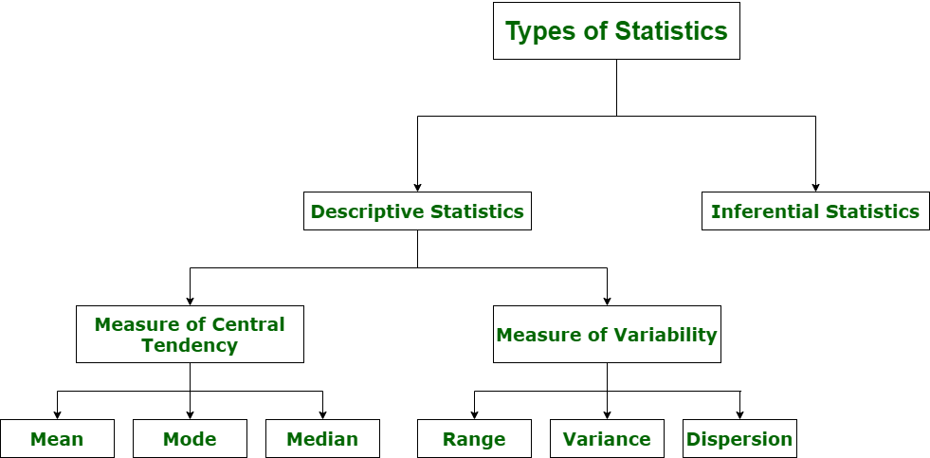
What is Statistical Learning?
Types of Statistics :

Slide 5
What is Statistical Learning?
Understanding the Descriptive Statistics
Describing and summarizing a single variable is called univariate analysis.
Describing a statistical relationship between two variables is called bivariate analysis.
Describing the statistical relationship between multiple variables is called multivariate analysis.
There are two types of descriptive Statistics –
Measure of central tendency
Measure of variability

Slide 6
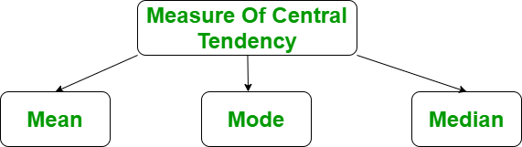
What is Statistical Learning?
Measure of central tendency
The measure of central tendency is a single value that attempts to describe the whole set of data. There are three main features of central tendency
Mean
Median
Median Low
Median High
Mode

Slide 7
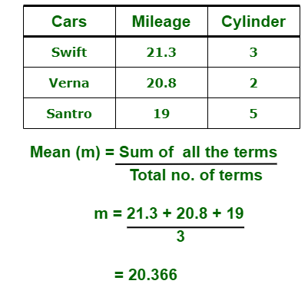
What is Statistical Learning?
Types of Statistics :
1. Descriptive Statistics :
Descriptive statistics uses data that provides a description of the population either through numerical calculation or graph or table. It provides a graphical summary of data. It is simply used for summarizing objects, etc. There are two categories in this as following below.
(a). Measure of central tendency –
Measure of central tendency is also known as summary statistics that is used to represents the center point or a particular value of a data set or sample set.
In statistics, there are three common measures of central tendency as shown below:
(i) Mean : It is measure of average of all value in a sample set. For example,

Slide 8
What is Statistical Learning?
Types of Statistics :
import statistics
# initializing list
li = [1, 2, 3, 3, 2, 2, 2, 1]
# using mean() to calculate average of list
# elements
print ("The average of list values is : ",end="")
print (statistics.mean(li))
Mean
It is the sum of observations divided by the total number of observations. It is also defined as average which is the sum divided by count.
Mean (\overline{x}) = \frac{\sum{x}}{n}
The mean() function returns the mean or average of the data passed in its arguments. If passed argument is empty, StatisticsError is raised.

Slide 9
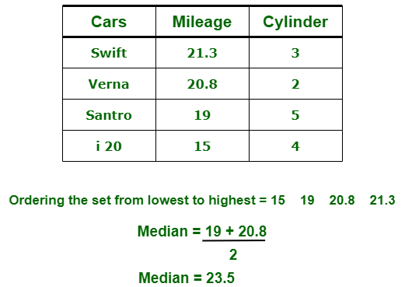
What is Statistical Learning?
Types of Statistics :
(ii) Median : It is measure of central value of a sample set. In these, data set is ordered from lowest to highest value and then finds exact middle. For example,

Slide 10

What is Statistical Learning?
Types of Statistics :
(iii) Mode : It is value most frequently arrived in sample set. The value repeated most of time in central set is actually mode. For example,

Slide 11
What is Statistical Learning?
(b). Measure of Variability –
Measure of Variability is also known as measure of dispersion and used to describe variability in a sample or population. In statistics, there are three common measures of variability as shown below:
(i) Range :
It is given measure of how to spread apart values in sample set or data set.
Range = Maximum value - Minimum value
(ii) Variance :
It simply describes how much a random variable defers from expected value and it is also computed as square of deviation.
In these formula, n represent total data points, ͞x represent mean of data points and xi represent individual data points.
(iii) Dispersion :
It is measure of dispersion of set of data from its mean.

Slide 12
What is Statistical Learning?
Inferential Statistics :
Inferential Statistics makes inference and prediction about population based on a sample of data taken from population. It generalizes a large dataset and applies probabilities to draw a conclusion. It is simply used for explaining meaning of descriptive stats. It is simply used to analyze, interpret result, and draw conclusion. Inferential Statistics is mainly related to and associated with hypothesis testing whose main target is to reject null hypothesis.
Hypothesis testing is a type of inferential procedure that takes help of sample data to evaluate and assess credibility of a hypothesis about a population. Inferential statistics are generally used to determine how strong relationship is within sample. But it is very difficult to obtain a population list and draw a random sample.

Slide 13
What is Statistical Learning?
Inferential statistics can be done with help of various steps as given below:
Obtain and start with a theory.
Generate a research hypothesis.
Operationalize or use variables
Identify or find out population to which we can apply study material.
Generate or form a null hypothesis for these population.
Collect and gather a sample of children from population and simply run study.
Then, perform all tests of statistical to clarify if obtained characteristics of sample are sufficiently different from what would be expected under null hypothesis so that we can be able to find and reject null hypothesis.

Slide 14
What is Statistical Learning?
Types of inferential statistics –
Various types of inferential statistics are used widely nowadays and are very easy to interpret. These are given below:
One sample test of difference/One sample hypothesis test
Confidence Interval
Contingency Tables and Chi-Square Statistic
T-test or Anova
Pearson Correlation
Bi-variate Regression
Multi-variate Regression

Slide 15
Introduction to Data

Slide 16
Data Presentation Using Charts and Diagrams

Slide 17
Measuring of Central Tendency, Variance

Slide 18
Understanding of Normal Distribution

Slide 19
Data Pre-processing

Slide 20
Feature Engineering ( Feature Extraction and Normalization) Assignments

Slide 21
Assignments
Test

Slide 22
Code for the presentation can be found here
Refer Readme.md of github repository for list of assignments:
https://github.com/tahirmirji/ai_with_python_keonics

Slide 23
Thank You

